Slide 1
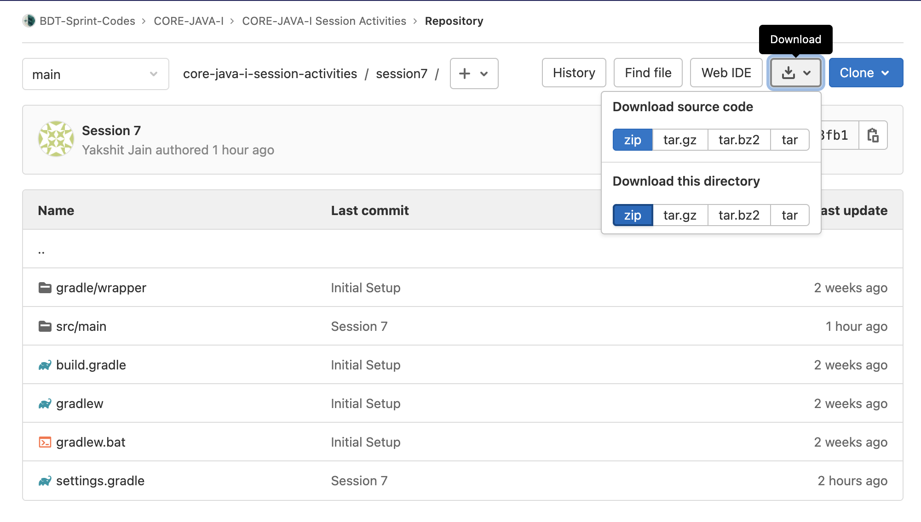
While folks are joining
Visit this Link: https://gitlab.crio.do/bdt-sprint-codes/core-java-i/core-java-i-session-activities/-/tree/main/session7
Click on Download > Download this directory > zip
Unzip and open this folder in your favorite IDE ( VSCode Preferred )
Notes:
Browsable Git: https://gitlab.crio.do/bdt-sprint-codes/core-java-i/core-java-i-session-activities/-/tree/main/session7

Slide 2

Crio Sprint: CORE-JAVA-1
Session 7

Slide 3
Today’s Session Agenda
QMoney Module 7 Debrief
MultiThreading - Thread LifeCycle

Slide 4
QMoney Module 7 - Handle User Issues - Debrief
What did we accomplish?
Add meaningful Error instead of showing stack trace to Portfolio Managers.
What Concepts did we learn?
Exception Handling

Slide 5
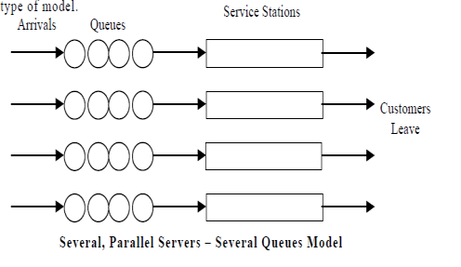


Scenario #1 - Avenue Supermarts
Cash Counter
Waiting Customers
Customers Leave
Very Long Queue
Estimated Waiting Time: 1hour
Me standing in the queue :|
Estimated Waiting Time: 5 min
Me standing in the queue : )

Slide 6
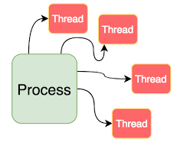
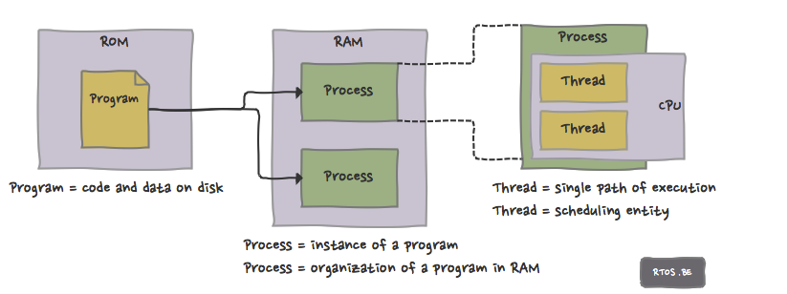

Process & Threads
What happens when you run any executable program?
Close Enough :)
Notes:
The program starts out as a text file of programming code.
The program is compiled or interpreted into binary form.
The program is loaded into memory.
The program becomes one or more running processes.
Processes are typically independent of each other.
Threads exist as the subset of a process.
Threads can communicate with each other more easily than processes can.
Threads are more vulnerable to problems caused by other threads in the same process

Slide 7
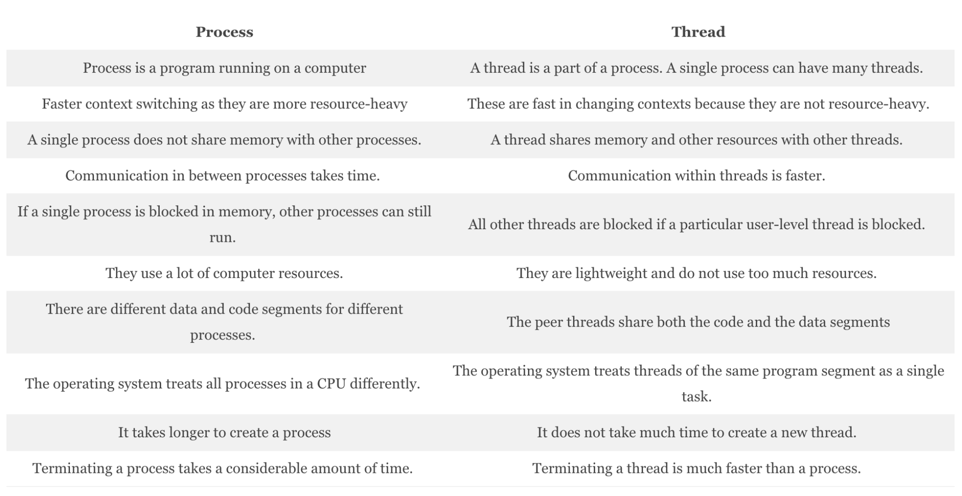
Process vs Threads ( For Reference )
Why Choose Process Over Thread, or Thread Over Process?
Notes:
Credits:- Multithreading in Java - Important Facts That You Should Know - DataFlair (data-flair.training)

Slide 8
Q1: What are the two different methods of creating a thread in Java? What method must be implemented in either case?
?
Creating a thread by deriving from the Thread class
Creating a thread by implementing the Runnable interface
public class Derived extends Thread
{
public void run()
{
/* Your implementation of the
thread here
*/
}
}
public class ThreadClass extends AnotherClass implements Runnable {
...
public void run()
{
/* This is where you would define the behavior of your thread, just as if this class were derived from the Thread class */
}
}
Which of the above techniques should we use for which scenarios?
Notes:
difference between extends thread and implements runnable
- The limitation with "extends Thread" approach is that if you extend Thread, you can not extend other class . Java does not support multiple inheritance.
While with implement runnable we can extend other class also.
- In "implements Runnable" , we are creating a different Runnable class for a specific task. It gives us the freedom to reuse the specific behavior task whenever required.
"extends Thread" contains both thread and job specific behavior code. Hence once thread completes execution , it can not be restart again.
- "implements Runnable" makes the code loosely-coupled and easier to read .Because the code is split into two classes . Thread class for the thread specific code and your Runnable implementation class for your task that should be run by a thread code.
"extends Thread" makes the code tightly coupled . Single class contains the thread code as well as the task that needs to be done by the thread.
there are many other difference also.
As per the above difference second approach has many advantages over the first approach so second approach is preferable.

Slide 9
Q2: What does the join method of Thread Class do?
?
join () method is used to join one thread with the end of the currently running thread.
It is a non-static method. join () method has an overloaded version. So we can mention the time duration in join () method also “.s”.
What is the below code doing?
public static void main (String[] args){
Thread t = new Thread ();
t.start ();
t.join ();
}
Notes:
What is the below code doing?
Based on the above code, the main thread has started the execution. When it reaches the code t.start() then ‘thread t’ starts the own stack for the execution. JVM switches between the main thread and ‘thread t’.
Once it reaches the code t.join() then ‘thread t’ alone is executed and completes its task, then only the main thread starts the execution.

Slide 10
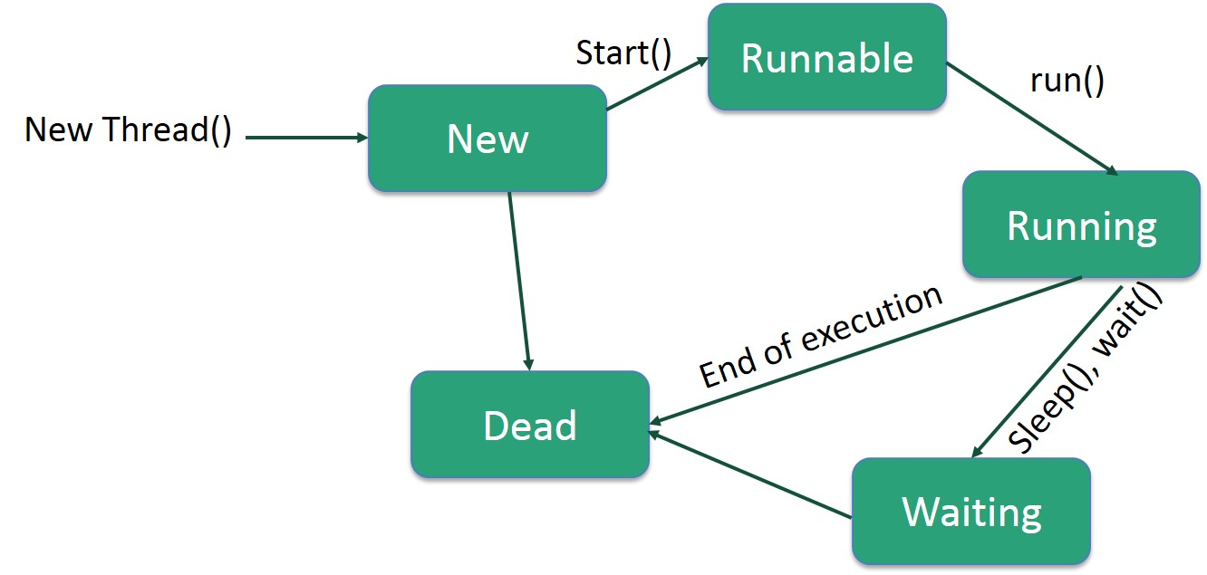
Activity #1 - Thread LifeCycle
Thread Creation Possible in 2 Ways
Extend Thread Class
Implementing Runnable interface
Run ThreadLifeCycle to check out each states.
Run ThreadJoinExample. What do you see?
Uncomment [t1,t2,t3].join() and run. What do you see?
Now we are back in order :)
Notes:
Credits:- Creating Thread In Java - Multithreading Tutorial | JavaProgramTo.com
Extend Thread Class
Run ThreadExtendsClass.java
Implementing Runnable interface
Run ThreadImplementsRunnable.java
Run ThreadJoinExample. What do you see?
For each execution, order of execution of thread is not predictable.

Slide 11
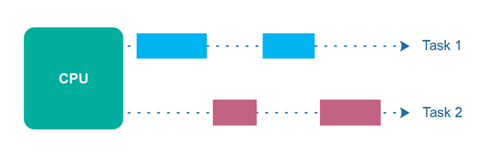
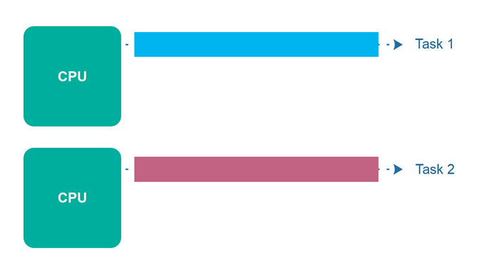
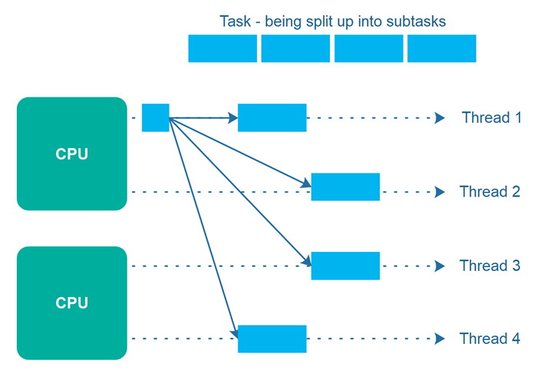
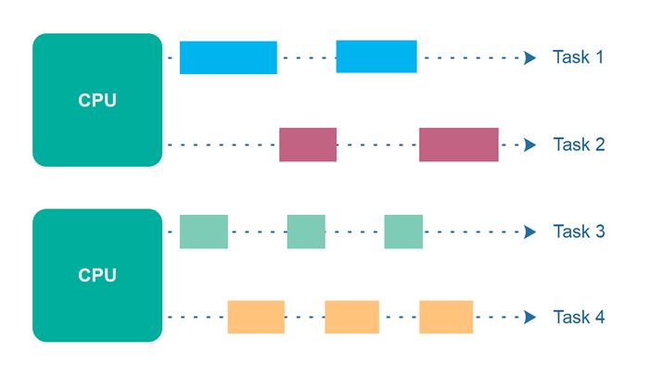
Concurrency vs. Parallelism
Concurrency
Parallel Execution
Parallel Concurrent Execution
Parallelism
Notes:
Credits:- Concurrency vs. Parallelism (jenkov.com)
Concurrency
Concurrency means that an application is making progress on more than one task - at the same time or at least seemingly at the same time (concurrently).
Parallel Execution
Parallel execution is when a computer has more than one CPU or CPU core, and makes progress on more than one task simultaneously.
Parallel Concurrent Execution
It is possible to have parallel concurrent execution, where threads are distributed among multiple CPUs. Thus, the threads executed on the same CPU are executed concurrently, whereas threads executed on different CPUs are executed in parallel.
Parallelism
The term parallelism means that an application splits its tasks up into smaller subtasks which can be processed in parallel, for instance on multiple CPUs at the exact same time. Thus, parallelism does not refer to the same execution model as parallel concurrent execution - even if they may look similar on the surface.
To achieve true parallelism your application must have more than one thread running - and each thread must run on separate CPUs / CPU cores / graphics card GPU cores or similar.

Slide 12
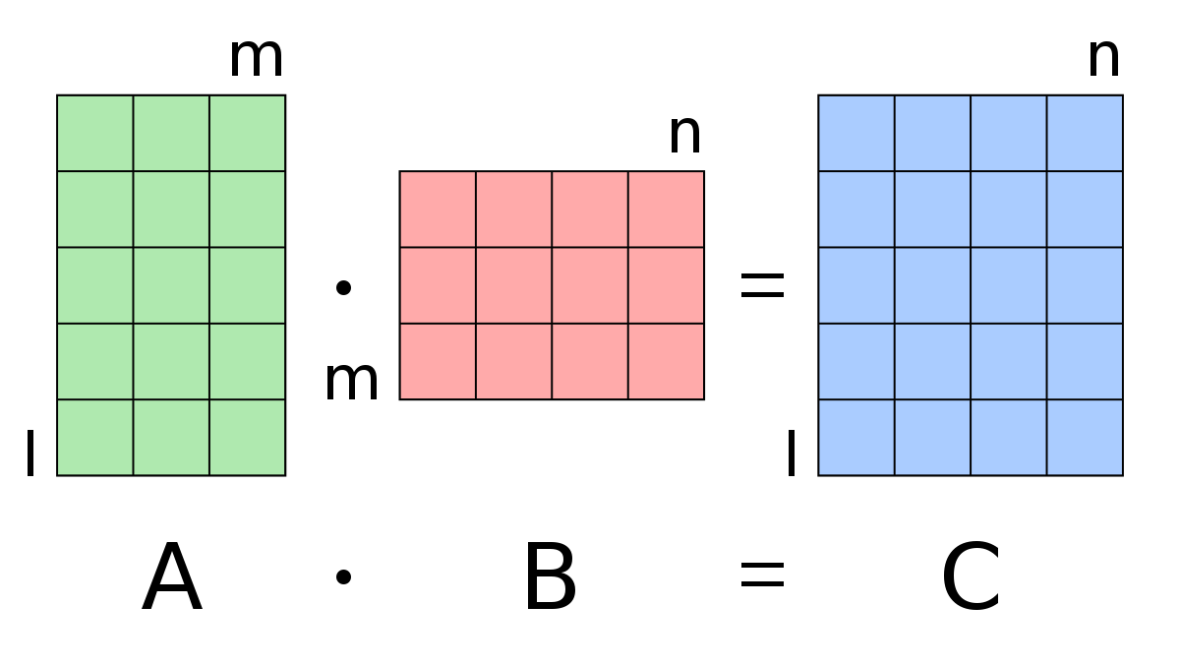
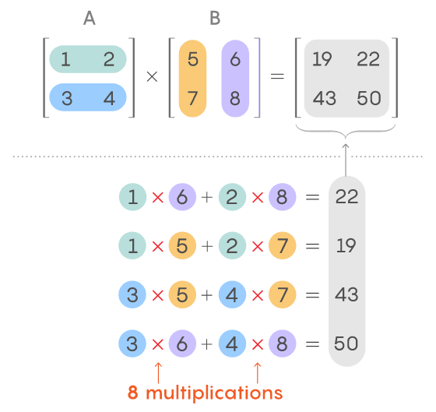
Activity #2 - Matrix Multiplication
How much time does it take to multiply 100 * 100 matrix on single thread? Try it out!
How can we achieve parallelism? Any ideas?
Split Row Multiplication into separate Threads
Parallelize Row Multiplication and run the program.
Compare the time required between Single and Multi Thread Execution for 100 * 100 Matrix. What do you see?
Thread 1
Wait for all the threads to complete execution.
Thread 2
Thread 3
Thread 4
Notes:
Credits:- Matrix Multiplication with Java Threads - Optimized Code (Parallel) | JavaProgramTo.com

Slide 13


Activity #3 - Image Inverter ( Try Execution at Home )
Image inverter inverts any RGB image.
Multi-Threaded Logic Supported
Parallelism is achieved by splitting and processing the image in row-wise manner.
Number of splits == Number of Threads
Images are available in 5 qualities
ULTRA_LOW
VERY_LOW
LOW
MEDIUM
HIGH
Tinker with code by changing Image Quality in FILE_SLUG and numOfThreads and measure the performance. What do you see?
When is single thread and multi-thread logic suitable for which scenario?
Tip:- It is best if Number of threads == Number of available processors.
Runtime.getRuntime().availableProcessors()
Notes:
Tinker with code by changing Image Quality in FILE_SLUG and numOfThreads and measure the performance. What do you see?
At certain num of threads and high image quality, application performs the best. After than increasing the number of threads doesn’t make any difference. Number of threads beyond the available processors leads to lot of context switching and should be avoided.
Single threaded outshines for low quality images sometimes. If Number of threads are high than overhead due to thread creation fails to outshine single threaded application.

Slide 14
Feedback
Thank you for joining in today.
We’d love to hear your thoughts and feedback - Feedback for CORE-JAVA-1 Session

Slide 15
Further Reading
Finally Getting the Most out of the Java Thread Pool – Stackify
Threads vs. Processes: A Look At How They Work Within Your Program (backblaze.com)
What Is a Thread? (iitk.ac.in)

Slide 16
References
Multithreading in Java - Important Facts That You Should Know - DataFlair (data-flair.training)
How web browsers use Processes and Threads | by Jeewantha Lahiru | Level Up Coding (gitconnected.com)
Creating Thread In Java - Multithreading Tutorial | JavaProgramTo.com
Matrix Multiplication with Java Threads - Optimized Code (Parallel) | JavaProgramTo.com
Concurrency vs. Parallelism (jenkov.com)

Slide 17
Thank you

